Slide 1
DV
Higher Education
Performance Dashboard
EduVision DV
Project Presentation
Presented by Aishwarya Todkari
Interactive Tableau Dashboard Suite

Slide 2
Project Overview
EduVision DV
What is EduVision DV?
Project: EduVision DV — Higher Education Performance Dashboard.
Purpose: Analyze global university performance across rankings, research, student diversity and country-level indicators.
Approach: Combine publicly available higher-education datasets, engineer meaningful KPIs and present them through interactive Tableau dashboards.
Final Deliverable: A unified Tableau workbook (.twbx) containing four interconnected dashboards.
2

Slide 3
Problem Statement
EduVision DV
Why this project?
Data is fragmented: University rankings, research indicators and student statistics are available across different datasets and formats.
Comparison is difficult: Users need a single view to compare institutions, countries and performance dimensions.
Raw metrics lack context: Ranking and research indicators can be difficult to interpret without calculated KPIs and visual comparisons.
Decision-making needs interactivity: Static reports do not provide flexible filtering, drill-downs and cross-dashboard exploration.
3

Slide 4
Objectives
EduVision DV
Primary Objectives
Expected Value
Integrate global university datasets into a common
analytical structure.
Clean, standardize and validate university, country
and ranking fields.
Engineer six education-performance KPIs.
Build four interactive Tableau dashboards.
Enable university-to-university comparison.
Support research and academic performance analysis.
Reveal student diversity and enrollment patterns.
Provide country-level education benchmarking.
4

Slide 5
System / Data Architecture
From raw data to insights
Public University
Datasets
Python + Pandas
Cleaning
KPI Engineering
& Validation
Tableau-ready
Dataset
University
Overview
Research
Analytics
Student
Analytics
Country
Analytics
Interactive filters, parameters and dashboard actions connect the four analytical views.
5

Slide 6
Project Workflow
End-to-end pipeline
1
2
3
4
5
6
7
Collect
Datasets
Clean &
Transform
Engineer
KPIs
Develop
Dashboards
Integrate
Workbook
Test &
Validate
Document &
Deliver
Output: a unified, interactive Tableau workbook (.twbx) for higher-education performance analysis.
6

Slide 7
Technology Stack
Tools used in the project
Data Collection
Python • Public QS / THE datasets
Data Processing
Pandas • NumPy
Data Cleaning
Python • Jupyter Notebook
KPI Engineering
Python calculations • Excel-ready output
Visualization
Tableau Desktop / Tableau Public
Dashboard UX
Filters • Parameters • Actions • Drill-downs
• Navigations
Documentation
Markdown • GitHub • Project reports • PPT
7

Slide 8
Education KPI Framework
Six core performance indicators
Global Ranking Score
Research Impact Score
Faculty-to-Student Ratio
Overall institutional standing
Influence of research output
Teaching capacity indicator
International Student %
Academic Reputation
Research Productivity Index
Global student diversity
Perceived academic strength
Research efficiency / output
KPIs convert raw ranking, research and student indicators into comparable measures for decision-making.
8

Slide 9
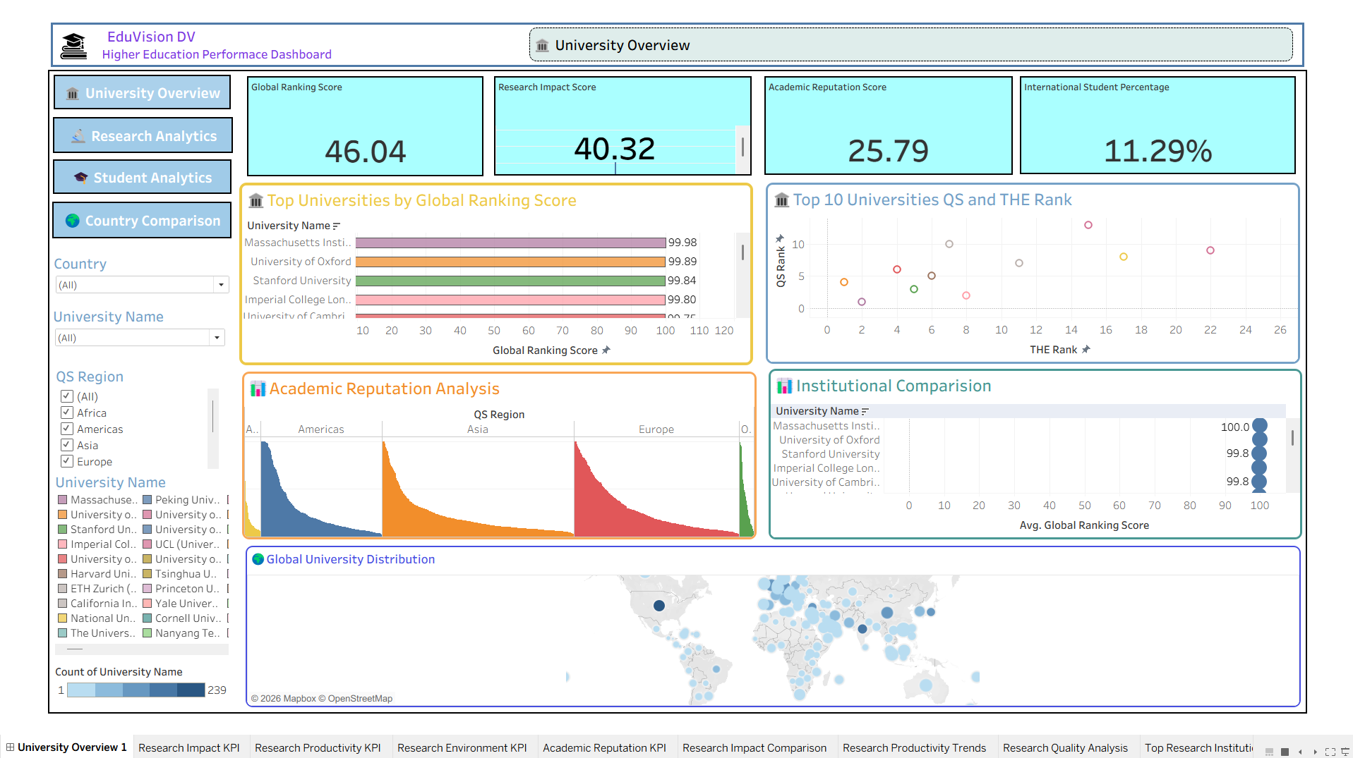
Dashboard 1 — University Overview
Implemented Dashboard
Key Insights & Features
Executive-level view of university performance.
KPI cards show Global Ranking, Research
Impact, Academic Reputation and International
Student Percentage.
Top-university ranking chart enables quick
identification of leading institutions.
QS vs THE rank scatter plot supports
ranking comparison.
Academic reputation analysis compares regions.
Global map provides geographic distribution of
universities.
Filters allow country, university and QS-region
exploration.
9

Slide 10
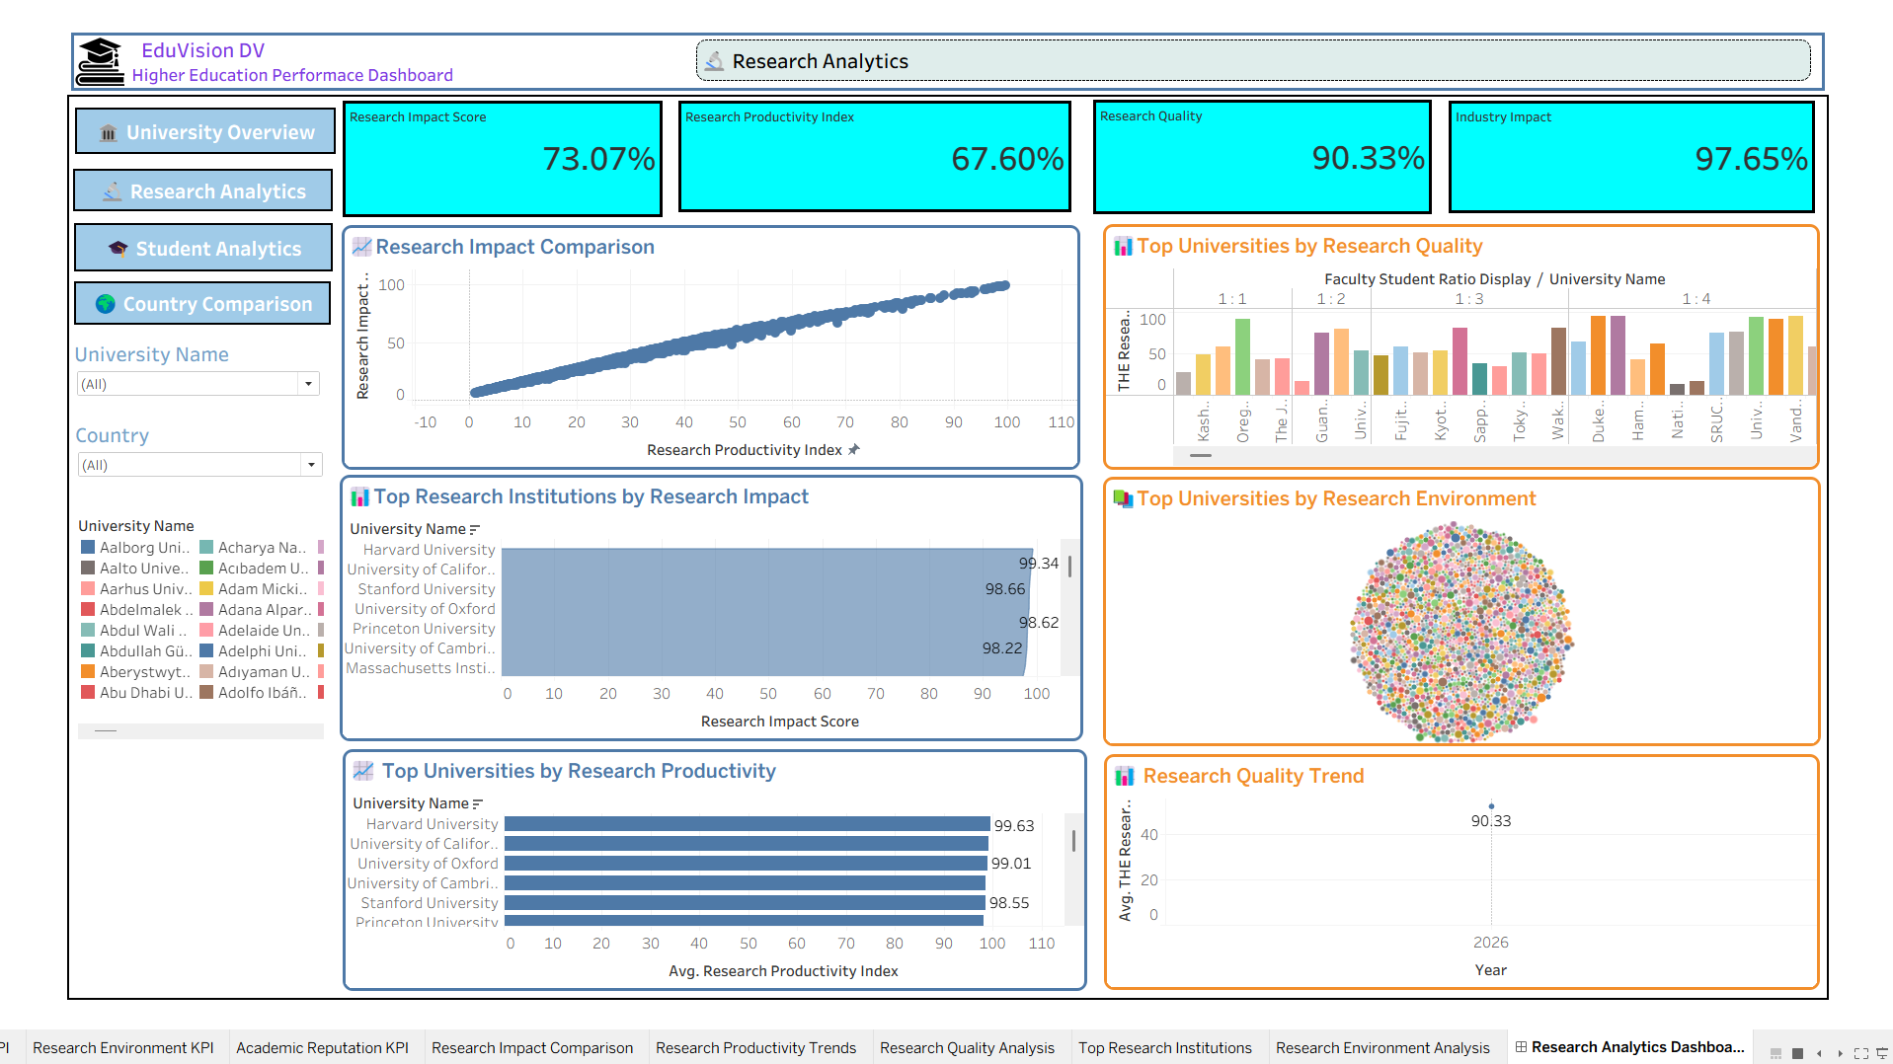
Dashboard 2 — Research Analytics
Implemented Dashboard
Key Insights & Features
Focuses on research impact, productivity,
quality and industry impact.
KPI cards summarize major research dimensions.
Research impact comparison shows relationship
with productivity.
Top research institutions identify high-impact
universities.
Research productivity chart ranks institutions by
productivity index.
Research environment view provides a visual
institution comparison.
Research quality trend summarizes the available
time dimension.
10

Slide 11
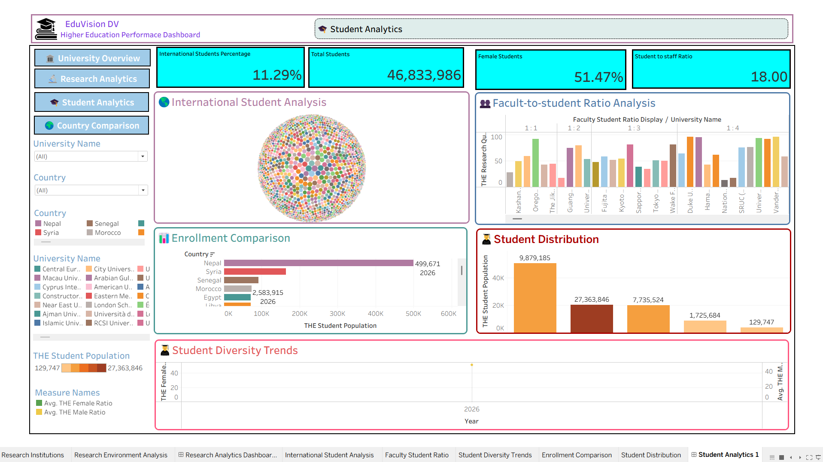
Dashboard 3 — Student Analytics
Implemented Dashboard
Key Insights & Features
Examines student population, diversity and
international participation.
KPI cards show international students, total
students, female-student share and
student-to-staff ratio.
International student analysis visualizes
global student diversity.
Enrollment comparison highlights differences
across countries.
Student distribution compares population sizes.
Faculty-to-student ratio analysis supports
teaching-capacity comparison.
Filters allow university and country-level
exploration.
11

Slide 12
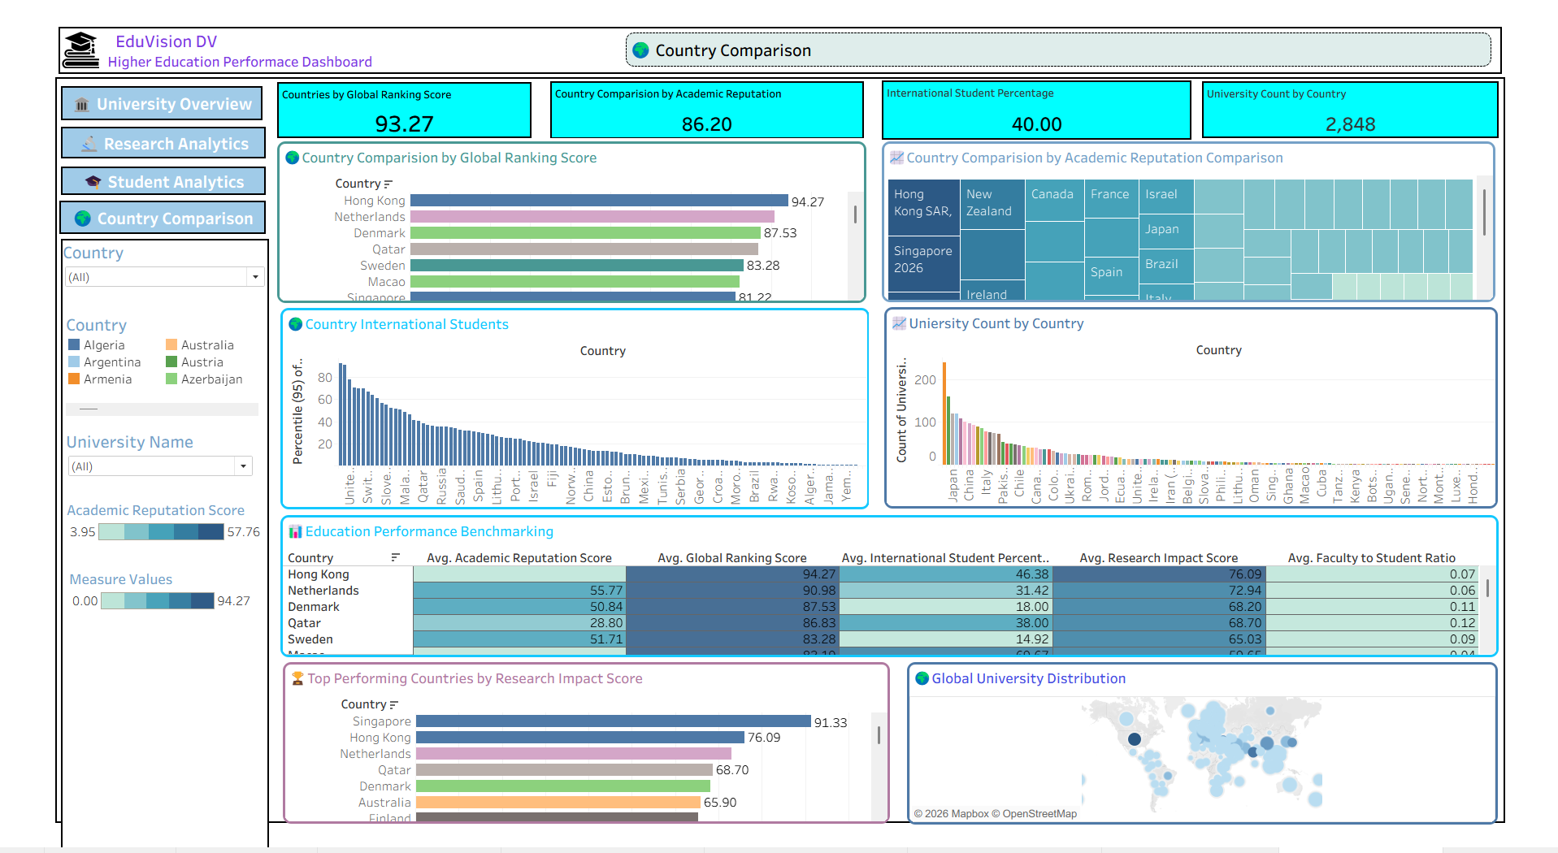
Dashboard 4 — Country Comparison
Implemented Dashboard
Key Insights & Features
Benchmarks countries using
education-performance indicators.
Global ranking score comparison identifies
high-performing countries.
Academic reputation is shown through a
comparative treemap.
International-student participation supports
global mobility analysis.
University count shows concentration of
institutions by country.
Benchmarking table compares academic
reputation, global ranking, international students,
research impact and faculty-to-student ratio.
Map provides a global distribution view.
12

Slide 13
Interactivity & Dashboard Integration
EduVision DV
Interactive Features
User Experience
University and country filters.
QS-region selection.
Cross-dashboard navigation.
Sorting and ranking comparisons.
Drill-down style exploration through charts.
Parameters / dashboard actions where applicable.
Consistent navigation across four dashboards.
KPI-first layout for quick understanding.
Charts support both overview and detailed analysis.
Geographic visuals provide global context.
Unified Tableau workbook keeps the analysis
connected.
13

Slide 14
Data Cleaning & KPI Engineering
EduVision DV
Data Preparation
KPI Engineering
Remove duplicate university records.
Standardize university names and country names.
Normalize ranking and performance metrics.
Handle missing values and inconsistent formats.
Merge QS and THE-related indicators into a
common structure.
Prepare Tableau-ready datasets.
Global Ranking Score.
Research Impact Score.
Faculty-to-Student Ratio.
International Student Percentage.
Academic Reputation Score.
Research Productivity Index.
14

Slide 15
Project Outcomes
What the dashboard delivers
Unified analytics
Four interconnected dashboards in one Tableau workbook.
Global comparison
Compare universities and countries using consistent indicators.
Actionable KPIs
Turn complex ranking and research metrics into easy-to-read summaries.
Interactive exploration
Use filters, drill-downs and comparisons to investigate patterns.
Portfolio-ready output
A polished Tableau dashboard suite suitable for academic and professional demonstration.
15

Slide 16
Future Enhancements
Next-generation capabilities
Real-time / scheduled data refresh
Predictive analytics
Automate ingestion from current ranking and university data sources.
Forecast ranking movement, enrollment trends and research performance.
AI-powered recommendations
Advanced geospatial analysis
Suggest universities or improvement areas based on user goals and
KPI patterns.
Add region-level clustering, mobility patterns and richer global maps.
Student-focused personalization
Cloud deployment
Allow students to compare institutions based on course, cost, location
and career goals.
Publish a scalable analytics portal with role-based access and
automated refresh.
16

Slide 17
Conclusion
Key takeaway
EduVision DV transforms complex higher-education data into clear,
interactive and decision-ready insights.
The project integrates university ranking, research, student and country-level indicators.
Four dashboards provide complementary perspectives while maintaining a unified analytical experience.
The solution demonstrates how data cleaning, KPI engineering and Tableau visualization can support
evidence-based education analysis.
17

Slide 18
Thank You
Higher Education Performance Dashboard
EduVision DV • Presented by Aishwarya Todkari

